Slide 1
Introduction & Building Blocks of Apache Hadoop
Session One

Slide 2
Overview of Hadoop
Started as a sub project of Nutch – Open source Search Engine
It is based on Google GFS and Map Reduce papers
Created by Doug Cutting and Nutch Team
It is an Operating System for data
It is data refinery
It is an Open source Project
Definition: It is an open source java framework for creating and running distributed applications which process vast amount of data on a cluster of commodity hardware
It is a versatile tool that allows new users to access the power of distributed computing
It scales to hundreds of Peta bytes of data

Slide 3
Features of Hadoop
Accessible - Hadoop runs on large clusters of commodity machines or on cloud computing services
Robust – Hadoop runs on commodity hardware, it is architected with the assumption of frequent hardware malfunctions. It can gracefully handle most such failures
Fault-tolerant – The system continuous even some parts of the system under failures
Simple - Hadoop allows users to quickly write efficient parallel code
Reliable – There is no loss of data, re-launches tasks, Replication factor allows to write more than one copy
Scalable - Hadoop scales linearly to handle larger data by adding more nodes to the cluster
WORM: It is a System which works “Write Once Read Many Times”
Offline: It is good for running Batch processing

Slide 4
Components of Hadoop
Hadoop Distributed File System
  is a distributed file system designed to run on commodity hardware in fault tolerant and reliable manner
Map Reduce Programming Model
  is a framework for writing applications which process vast amounts of data in-parallel on large clusters of commodity hardware in a reliable, fault-tolerant manner
Common Utilities
  a set of common utilities and libraries that support the other Hadoop subprojects
Ecosystem
  A set of projects which bring the real power of Hadoop to all users.
  Some of them are:
    HBase – Columnar Non-relational Database
    Pig – High level Data flow language
    Hive – Data Ware Housing Infrastructure
    Mahout – Machine Learning framework
    Many Other……

Slide 5
Comparison with SQL Databases
Hadoop is not replacement of Relational databases, it is compliment to RDBMS. It is useful to extend the Databases.
Hadoop | RDBMS
Scale out | Scale up
Key-value pairs | Records/Tuple
Batch Processing | Real time processing
Functional Programming | Declarative SQL

Slide 6
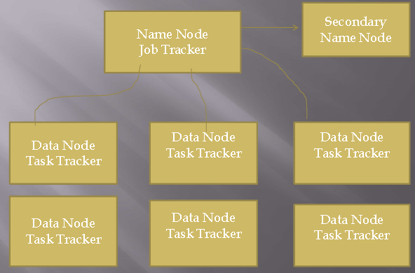
Hadoop Architecture
It is a typical Master-Slave Architecture.
It contains One Master [NameNode + JobTracker] and n number of Slaves [DataNode + TaskTracker].

Slide 7
Building Blocks of Hadoop
The Hadoop Architecture contains five Hadoop daemons
Name Node
  It is a master for HDFS and directs the DataNodes to perform low level I/O tasks.
  It is responsible for holding the entire HDFS Metadata Information of the Hadoop cluster.
  It is Memory as well as I/O Intensive.
  It is a Single point of failure to cluster.
Data Node
  It is responsible for holding the user data
  It will do all the grunt work like reading and writing data.
  It will interact with other DataNodes (to replicate data), External clients (Read/Write) with help of NameNode.
  It gives heartbeat to NameNode for every 3 seconds to report the block information.
Secondary Name Node
  It is a Mirror Image of NameNode
  it communicates with the NameNode to take snapshots of the metadata at intervals defined by the cluster configuration

Slide 8
Cont…
  It is used to handle NameNode failures and helps to minimize the downtime and loss of data
Job Tracker
  It is a master for Map Reduce of Hadoop Cluster
  It is point of contact between Hadoop cluster and applications (jobs).
  It determines the execution plan by determining which files to process, assigns nodes to different tasks, and monitors all tasks as they are running
  It will re-launch the failed tasks automatically
Task Tracker
  It is actual worker node of Hadoop Cluster
  It manage the execution of individual tasks on each slave node
  It can spawn multiple JVMs to handle many map or reduce tasks in parallel
  It gives heartbeat to JobTracker to report about the job progress, any tasks failures.

